Slide 1
FAQ chatbot using Fine-Tuned LLM
Members:
Bal Narendra Sapa
Ajay Kumar Jagu

Slide 2
Agenda
Introduction
Statement of value
Dataset
Dataset Preprocessing
PEFT Configuration
Training
Metrics

Slide 3
Introduction
We will be building a FAQ chatbot for an E-Commerce site with the help of Large Language Models.
We will take an LLM and fine-tune it on custom dataset
A Chatbot finetuned periodically, can answer generally asked questions.

Slide 4
Statement of value
Implementing a chatbot for FAQs, especially using Retrieval Augmented Generation (RAG), can significantly benefit companies by reducing reliance on customer support. RAG models, which involve generating embeddings for documented FAQs and combining them with user queries, provide efficient answers without the need for storing embeddings post-answering. However, this approach may be resource-intensive for large companies as embeddings must be passed to the language model (LLM) with each query, leading to potential scalability and storage challenges.
On the other hand, employing a fine-tuned model trained on private data addresses these issues. It doesn't require constant embedding generation, ensuring independence in answering future questions. Monthly fine-tuning keeps the model up-to-date, offering a cost-effective solution compared to continual embedding generation and storage concerns.

Slide 5
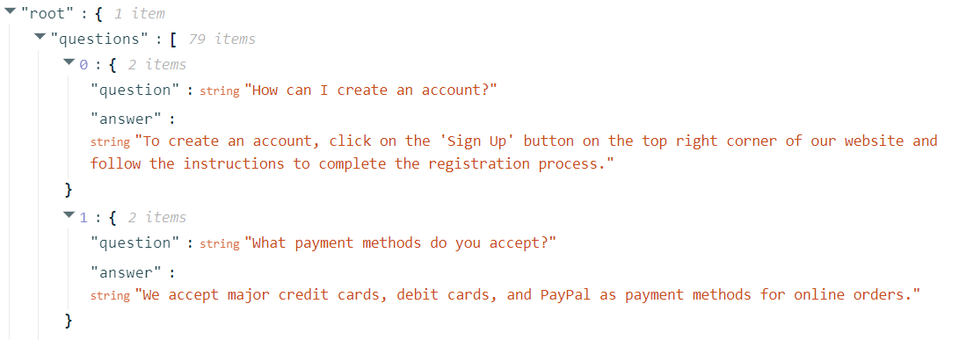
Dataset
We have taken the dataset from Kaggle.
Click here to the dataset.
The dataset looks like shown below.

Slide 6
Dataset Preprocessing
Raw dataset is converted into a huggingface compatible dataset for easier processing.
Then the samples are tokenized using the tokenizer from the original model(Falcon 7b).

Slide 7
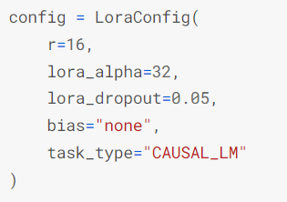
PEFT Configuration
Original weights are frozen and on top of them new parameters are introduced and trained.
Parameters for Lora are taken as shown in
image

Slide 8
Training
FALCON-7B llm model is taken as base model
Training requires a CPU vRAM of 30 gigs and A GPU vRAM of 20 gigs
We have trained the model on Kaggle. We tried using Google colab but couldn’t be able to run because of low memory.

Slide 9
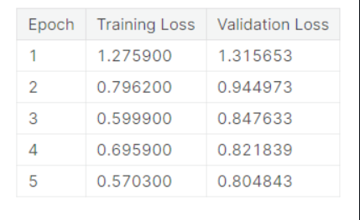
Metrics
Cross Entropy loss is used here.
As we can see the validation loss is decreasing.

Slide 10
Thank you
Bal Narendra Sapa​
Ajay Kumar Jagu

